Slide 1
Stimulus Blocked Response Labeling

Slide 2
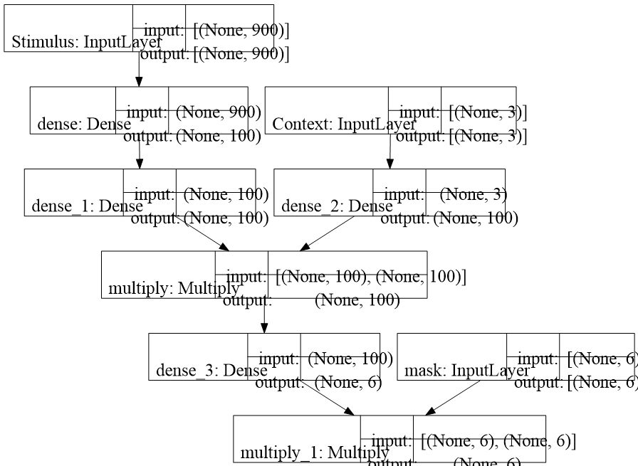

Slide 3
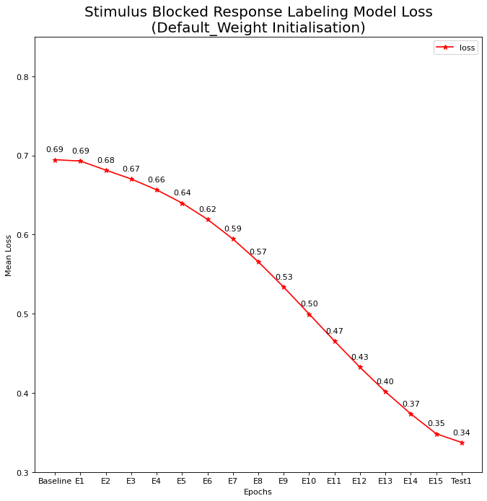
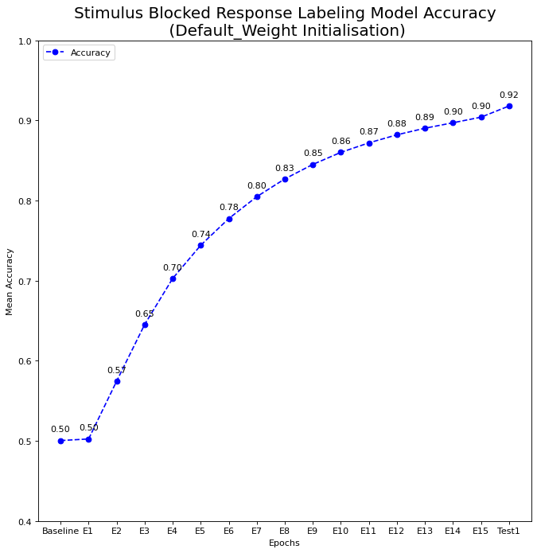
1000 Simulations default weight initialization:

Slide 4
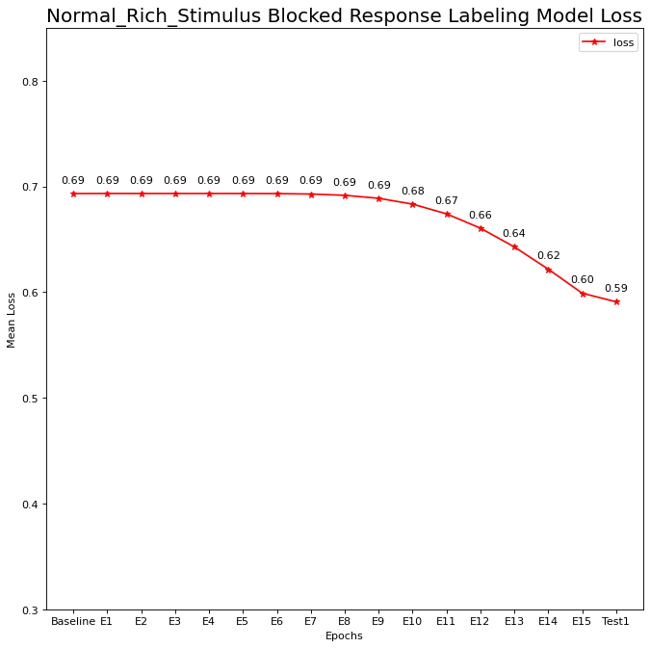
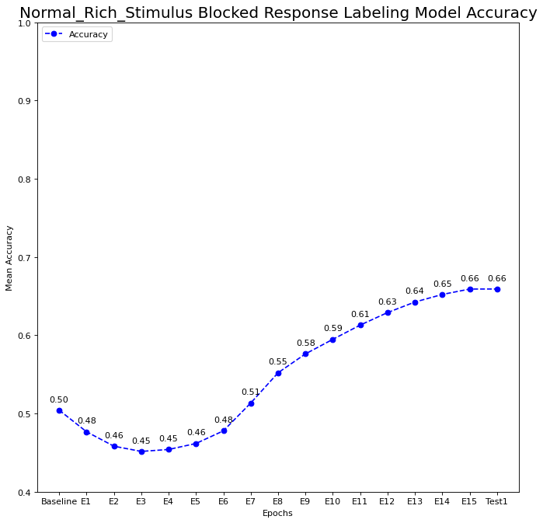
1000 Simulations Normal Rich weight initialization:

Slide 5
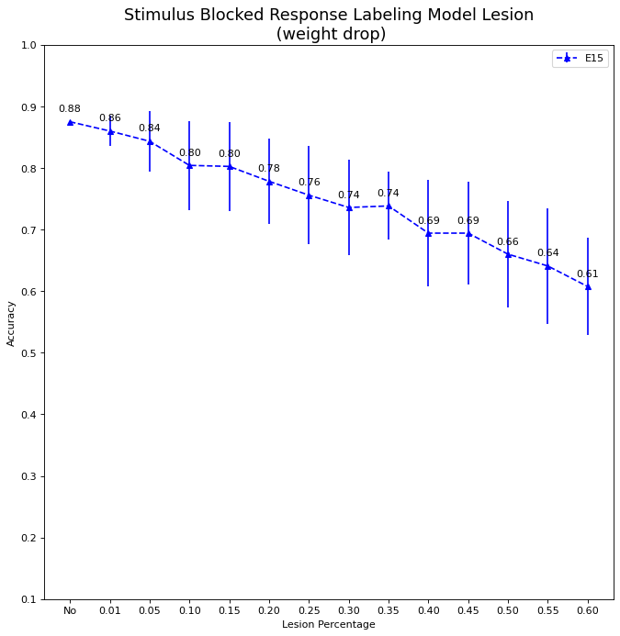
Model Lesion drop weight different percentage (avg from 50 times)

Slide 6
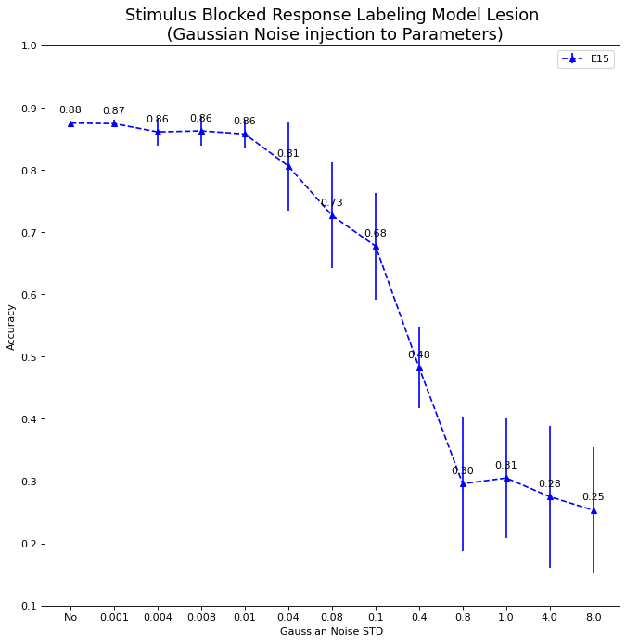
Model Lesion Gaussian Noise injection with different std (avg from 50 times)

Slide 7
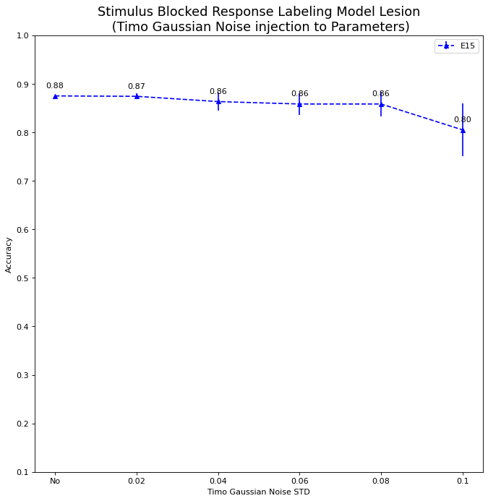
Model Lesion Timo Gaussian Noise injection with different std (avg from 50 times)

Slide 8
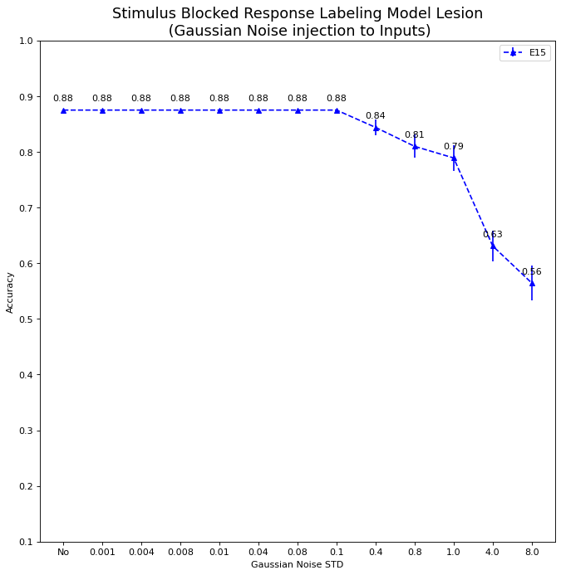
Gaussian Noise injection with different std to Input (avg from 50 times) :

